Slide 1



Project Title: E-Commerce Web Application Course Code: CSE412, Section: 02, Submitted to: Yasin Sazid Software Engineering
1
Team :3

Slide 2


MEET THE TEAM
2
Tausif Ahmed
Tarek Hasan
Md. Mehedi Hasan
Khandaker Hasan Mahmud

Slide 3
TABLE OF CONTENTS
Stakeholders
Technology Stack
Project Oerview & Scope
Functional & Non-F Requirements
Wow Features & QFD
Requirements Modeling
3
01
02
03
04
07
08
05
06
Software Testing
Software & UI Design
09
10
11
12
Bug Fixes
Deployment
Future Work
Conclusion

Slide 4

Project Oerview & Scope
4
A dynamic web platform for online shopping
Features include browsing, purchasing, and
managing products
Technologies used: PHP, MySQL, Bootstrap
Allows feedback, seller info, and real-time tracking
User auth, product management
Cart and order system

Slide 5
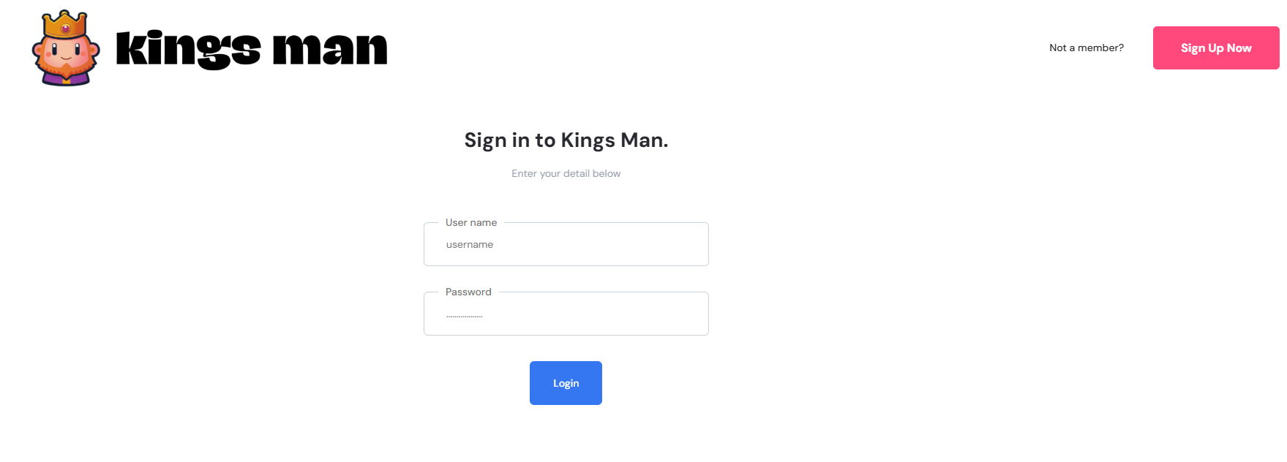
Stakeholders
5
Primary: Customers, Sellers, Administrators
Secondary: Payment Providers, Delivery Partners
Technical: Developers, System Admins

Slide 6

Technology Stack
6
Frontend: HTML, CSS, JS
Backend: PHP, Node.js (Express)
Database: MySQL
Hosting: XAMPP, GitHub
Design: Figma

Slide 7
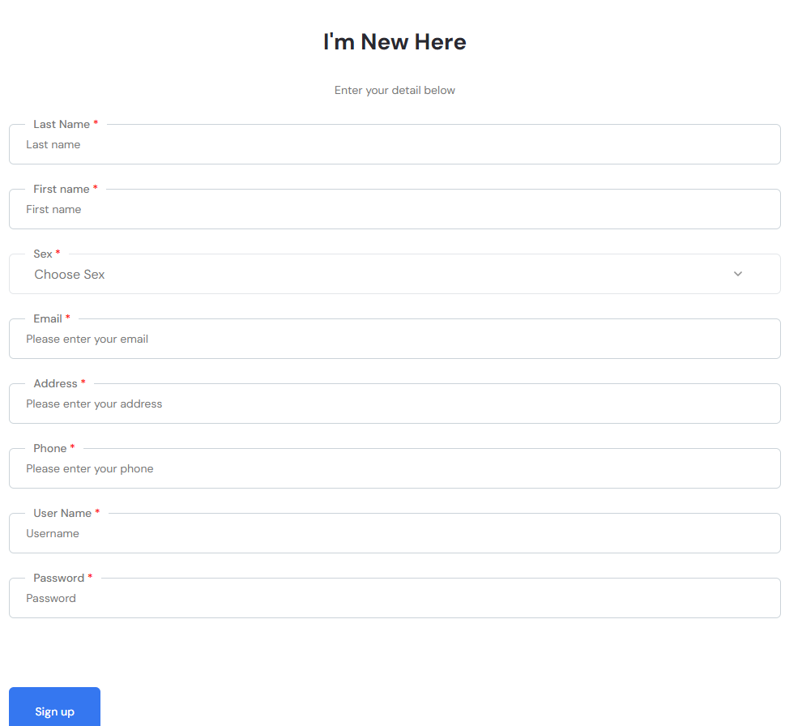
Functional & Non-F Requirements
Functional Requirements:
Non-F Requirements:
7
Sign-up/login, cart, wishlist, order tracking
Response time < 2 seconds under normal load
Image optimization for fast page loading
Security, performance (<3s load), 95% uptime

Slide 8

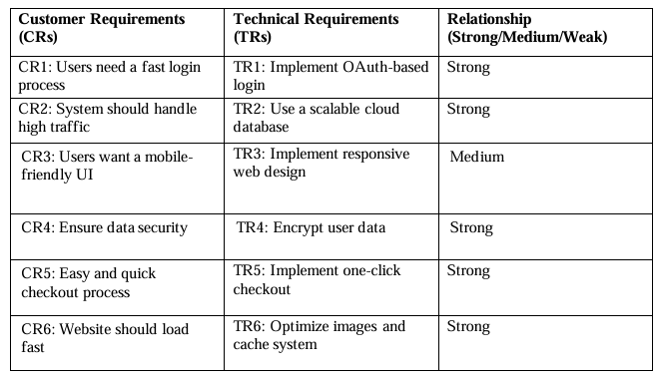
Wow Features & QFD
QFD
Wow Features
8
Customer Requirements: Secure payments, easy navigation
Engineering Requirements: SSL, scalable DB, responsive UI
Matrix used: House of Quality
AR Product Preview
Smart Order Tracking with live updates

Slide 9
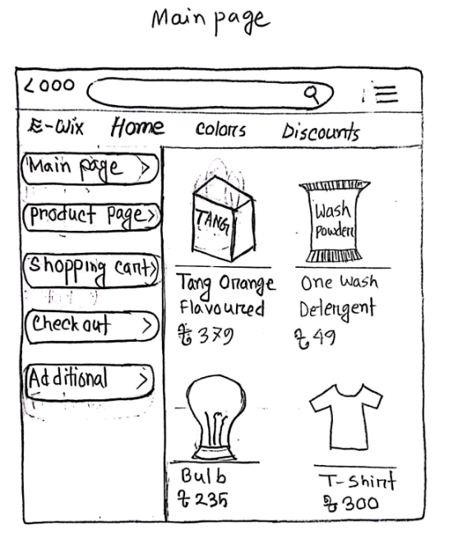
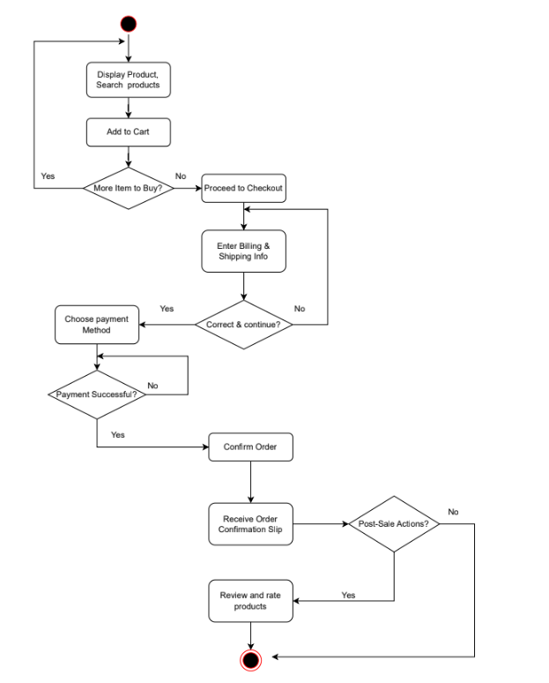
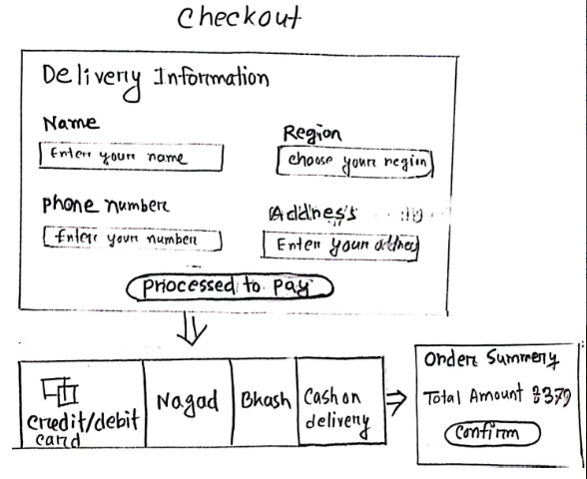
Requirements Modeling
9
Activity Diagrams
Initial UI Sketches

Slide 10
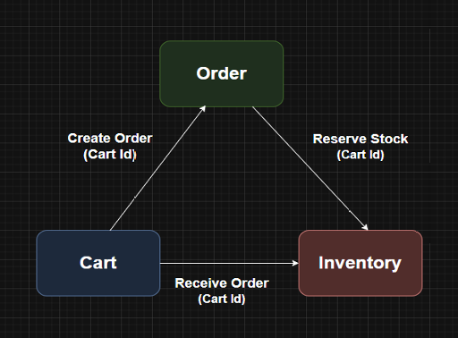
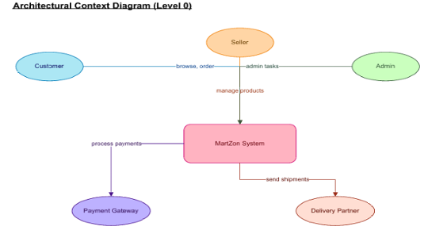
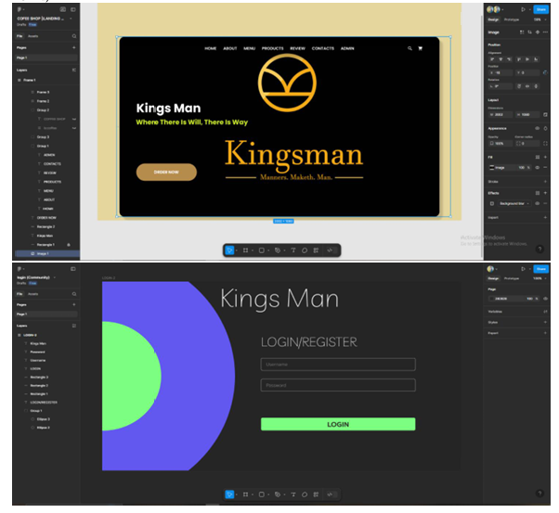
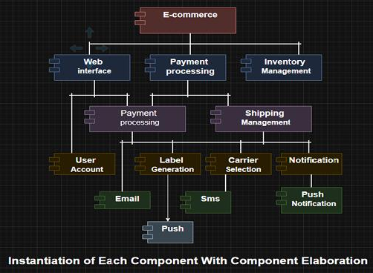
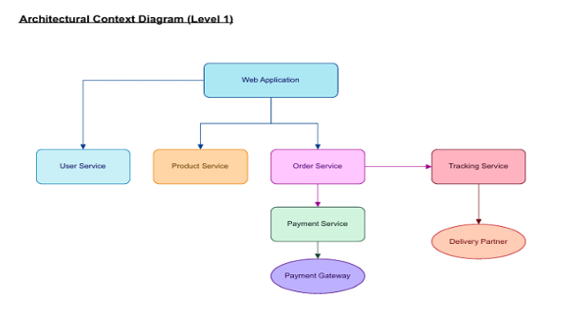
Software & UI Design
10
Architectural Context Diagram
Component-level Diagrams
UI Wireframes/Prototypes

Slide 11
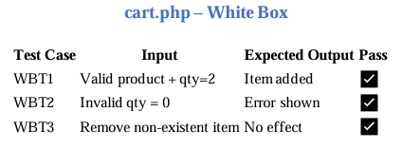
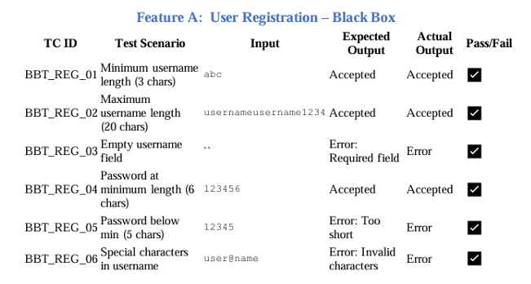
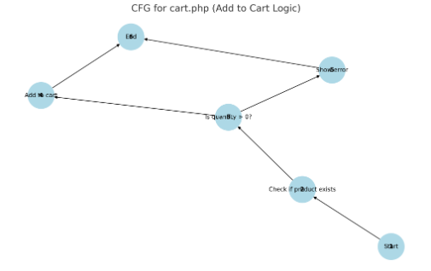
Software Testing
White Box Testing:
Black Box Testing:
11
Cart Logic & Registration Logic (CFG)
Registration and Order Placement
Boundary Value Analysis

Slide 12
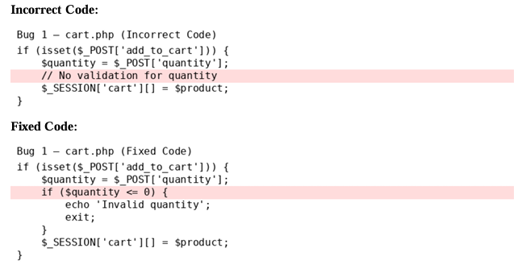
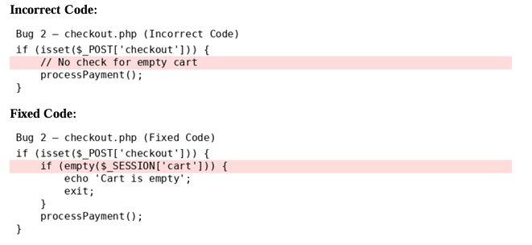
Bug Fixes
12
Bug 1: cart.php (Allows Quantity = 0)
Bug 2: checkout.php – Checkout Without Cart Items

Slide 13

Deployment
13
Local XAMPP Setup:
Install XAMPP
Move project to htdocs
Create DB in phpMyAdmin
Import SQL dump
Configure and test
Why XAMPP?
We tried using free hosting platforms like Vercel, but were unable to proceed since our PHP-based application with a MySQL database requires a paid hosting service that supports backend processing and databases.

Slide 14

Future Work
14
Add database & real-time payment gateway
Implement admin dashboard
Improve UI with responsive frameworks
Enhance security and filtering
Mobile-Friendly UI
Add Product Search Bar

Slide 15

Conclusion
15
Built a basic e-commerce website using PHP and MySQL
Added features like login, product view, cart, and checkout
Learned how to design, develop, and test a web application
Fixed bugs and improved basic security
Faced some limits like no real payment and simple UI
Gained useful experience in web development

Slide 16
THANK YOU
16

